Slide 1

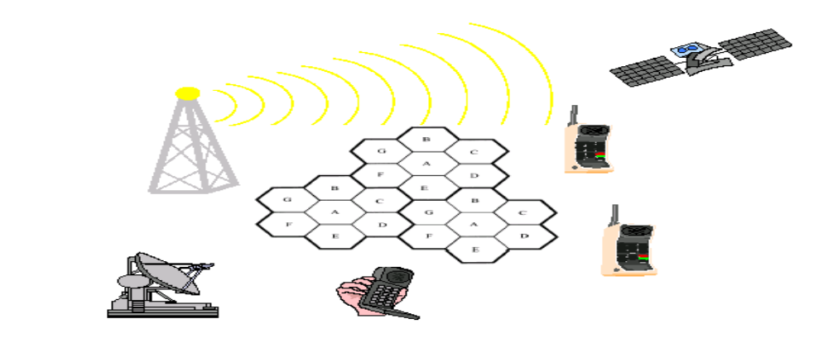
Chapter Four
GSM and GPRS
Wireless Networks

Slide 2
Introduction
Global System for Mobile Communications (GSM) is a digital wireless network standard.
Goal : was to provide a mobile phone system that allows users to roam throughout Europe and provides voice services compatible to Integrated Services Digital Network (ISDN )and other PSTN systems.
Contain basic requirements such as Services ,Quality of Services and Security, Radio Frequency Utilization, Network and cost.
An international standardized signaling system will be used for switching and mobility management.
The quality for voice telephony of GSM will be at least as good as the previous analog systems.

Slide 3
Basic Requirements of GSM
Services.
      The system will provide service portability; that is, MS can be used in all participating countries.
Quality of Services and Security.
      The quality for voice telephony of GSM will be at least as good as the previous analog systems.
      The system will be capable of offering information encryption with lightly extra cost.
Radio Frequency Utilization.
      The system will permit a high level of spectrum efficiency.
      The system will be capable of operating in the entire allocated frequency band, and coexist with the earlier system in the same frequency band.

Slide 4
Basic Requirements of GSM…
Network.
      The identification and numbering plans will be based on relevant ITU recommendations.
      An international standardized signaling system will be used for switching and mobility management.
      The exiting fixed public networks should not be significantly modified.
Cost.
      The system parameters will be chosen with a view to limiting the cost of the complete system, in particular MS.

Slide 5
GSM Technologies
A 2G cellular network (a digital network for voice communication)
Circuit switching for voice (mainly)/data (limited) transmission rate
  Connection-oriented service: establish a communication path (channel) for point-to-point communication
Multiplexing
  Frequency division multiplexing (FDM) plus Time division multiplexing (TDM)
  Uses 124 channels per cell, each channel can support 8 users through TDM (992 users max)
  Some channels are used for control signals, etc
Mobility management
  Two-tier architecture: HLR and VLR
  Location area for location update together with paging for searching
Services
  Mainly for voice communication
  Data communication is very limited (i.e., 9.6kbit/s) and supporting SMS

Slide 6
Performance Characteristics of GSM
Comparing with 1G cellular network
Communication
  Mobile communication for voice and data services
Total mobility
  International access, chip-card enables use of access points of different providers (roaming services)
Worldwide connectivity
  One number, the network handles localization and interoperability
High capacity
  Better frequency efficiency (frequency reuses), smaller cells, more customers per cell
High transmission quality
  High audio quality and reliability for wireless, uninterrupted phone calls at higher speeds (e.g., from cars, trains)
Security functions
  encryption, authentication via chip-card and PIN

Slide 7
GSM Services
Voice
Messaging
Entertainment
Location based service
Video Services

Slide 8
GSM Services : Voice
Voicemail- like a traditional answer machine.
Call Waiting
Call Hold
Call Forwarding
  the option of diverting incoming calls to another number.
Call Barring /Restrictions
  to restrict incoming or outgoing calls
Call conference
Push-to-Talk over Cellular(PoC/PTT)
  allow people to use their phones as walkie-talkies, merely pushing a button to talk to another user or group of users.
Notes:
like a traditional answer machine. If your line is engaged or you don't answer an incoming call after a pre-specified number of rings, your mobile operator diverts the caller to a voicemail system. The caller is welcomed by a pre-recorded greeting and given the opportunity to leave a message.
You are alerted to a new voicemail by a text-message or a call from your operator. You can then retrieve the new message by dialling a number provided by your operator.

Slide 9
GSM Services : Messaging
SMS (Short Messaging Service)
  up to 160 characters long
  Billions of text messages are sent worldwide every week.
  It is estimated that a worldwide total of 1 trillion text messages were sent in 2005.
  users subscribe to services that send news, sport and entertainment content to a mobile phone in the form of an SMS.
MMS (Multimedia Messaging Service)
  additional media types: text, picture, audio, video, or a combination of all four.
  phone that is running over a GPRS or 3GSM network is required.

Slide 10
GSM Services : Messaging
Instant Messaging
  an IP-based (Internet Protocol) application that can provide real-time written communication between people using a PC or Laptop.
Email
  2.5G (GPRS) and 3G network
  There are a wide variety of handsets available today that support wireless push email services.
  With push email, emails are sent directly to the mobile device as soon as the email server receives them rather than waiting for the user or email client to request the email.
Notes:
Push refers to technologies that allow a central system, for example the mobile phone network, to send – or push – information to an end-user without any action on their part or on the part of the mobile device.

Slide 11
GSM Services : Location Based Services
LBS provide personalized services to the user on request, based on their current position nearby restaurants, hotels or other location-specific content such as maps.
Cell-ID
  identifying which base station the user is currently connected
  is accurate to an area of between 200 meters and 1 kilometer.
GPS
  needs a chip inside the phone, adding to cost, weight and power requirement, suffer delays (sometimes more than a minute)

Slide 12
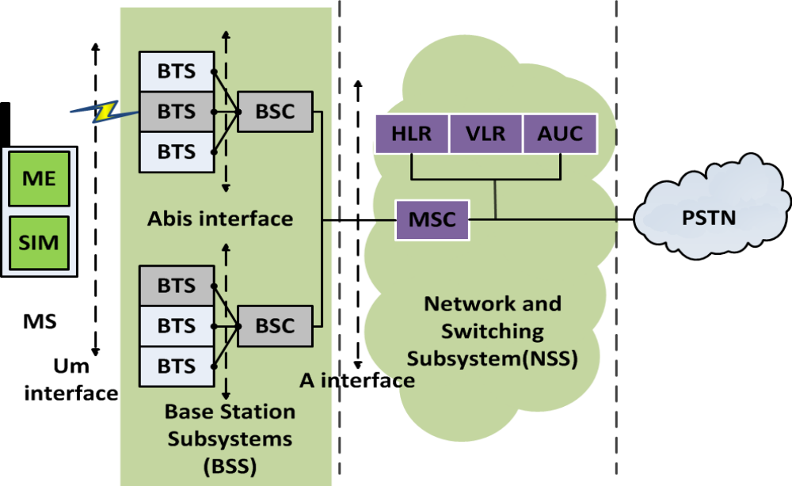
GSM Architecture

Slide 13
Mobile Station (MS) / Mobile Terminal (MT)
The MS consists of two parts:
  A. The Subscriber Identity Module (SIM)
    can be A smart card, usually the size of a credit card
    A smaller-sized “plug-in SIM”
    A smart card that can be perforated, which contains a plug-in SIM that can be broken out of it.
The SIM is protected by a Personal Identity Number (PIN) between 4 to 8 digits.
    To use MS, the user is asked to enter the PIN.
    If the number is not correctly entered in 3 time, the SIM is locked.
To unlock SIM, the user is asked to enter the 8-digit PIN unblocking Key (PUK). In a broader definition, the MS also includes a third part called
      Terminal Equipment (TE), which can be a PDA or PC connected to ME.

Slide 14
Mobile Station (MS)….
Subscriber-Related Information includes
    PIN, and PUK codes,
    A list of abbreviated and Customized Short Dialing Numbers,
    Short Message Received when the subscriber is not present, and
    Names of Preferred Networks to provide service.
Parts of the SIM information can be modified by the subscriber either by keypad or a PC using an RS232 connection.
The SIM card can be updated over the air through SIM Toolkit.

Slide 15
Mobile Station (MS)….
B. Mobile Equipment (ME)
The ME contains
    The Noncustomer-Related Hardware and
    Software Specific to the Radio Interface.
When the SIM is removed from an MS, the remaining ME cannot be used for reaching the service, except for emergency calls.
Usually, the MS is the property of the subscriber.
The SIM is the property of the service provider.

Slide 16
Base Station System (BSS): BTS
Base Transceiver Station (BTS) contains
    Transmitter, Receiver, and
    Signaling Equipment Specific to the radio interface in order to contact the MSs.
    Transcoder/Rate Adapter Unit (TRAU) carries out GSM-specific speech encoding/decoding and rate adaptation in data transmission.
Base Station Controller (BSC)
Is responsible for the switching functions in the BSS, and
Is in turn connected to an MSC in the NSS.
The BSC supports radio channel allocation/release and handoff management.
A BSC may connect to several BTSs and maintain cell configuration data of these BTSs.
The BSC communicates with the BTSs using ISDN protocols via the A-bis.
Capacity planning for BSC is very important.

Slide 17
Network and Switching Subsystem (NSS)
MSC performs the basic switching function following a signaling protocol used in the telephone network.
HLR and VLR maintain the current location of the MS.
Authentication Center (AuC) is used in the security data management for the user.
Gateway MSC (GMSC) routes an incoming call to an MSC by interrogating the HLR directory.
      A MSC can function as the GMSC by including appropriate software and HLR interrogation functions.

Slide 18
Radio Interface－Um Interface
The GSM radio link uses both FDMA and TDMA technologies.
935-960 MHz (downlink); 890-915 MHz (uplink) ,
124 pairs × 200 KHz
Discontinuous transmission/reception is used to save the power consumption of the MS.
Notes:
Radio subsystem
The Radio Subsystem (RSS) comprises the cellular mobile network up to the switching centers
Components
Base Station Subsystem (BSS):
Base Transceiver Station (BTS):
radio components including sender, receiver, antenna
if directed antennas are used one BTS can cover several cells
Base Station Controller (BSC):
switching between BTSs, controlling BTSs,
mapping of radio channels (U_{m}) onto terrestrial channels (A interface)
BSS = BSC + sum(BTS)
Mobile Stations (MS)
MS=ME(mobile Equipment ) + SIM( subscriber identity module)

Slide 19
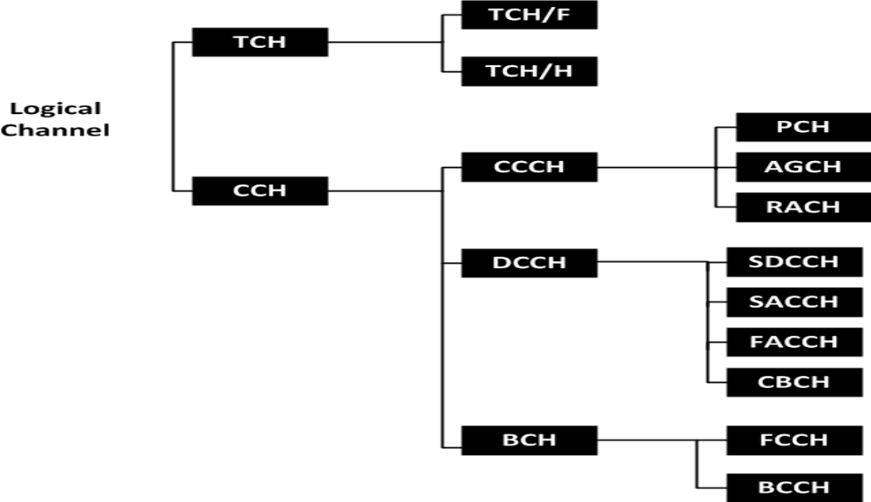
Logical Channels

Slide 20
Traffic Channel (TCH)
TCHs are intended to carry user information (speech or data).
  Full-rate TCH (TCH/F) provides transmission speed of 13 Kbps for speech or 9.6, 4.8 or 2.4 Kbps for data.
      Enhanced full-rate (EFR) speech coders have been implemented to improve the speech quality.
  Half-rate TCH (TCH/H) allows transmission of 6.5 Kbps speech, or 4.8 or 2.4 Kbps of data.

Slide 21
Common Control Channel (CCCH)
Paging Channel (PCH) (down link) used by the network to page the destination MS in call termination.
Access Grant Channel (AGCH) (down link) used by the network to indicate radio link allocation upon prime access of an MS.
Random Access Channel (RACH) (up link) used by the MSs for initial access to the network.
Several MSs may access the same RACH, potentially resulting in collisions. The slotted Aloha protocol is adopted in GSM to resolve access collision.

Slide 22
Dedicated Control Channel (DCCH)
(DCCH) is for dedicated use by a specific MS.
Standalone Dedicated Control Channel (SDCCH; Downlink/Uplink) used only for signaling and for short message.
Slow Associated Control Channel (SACCH; Downlink/Uplink)
    Associated with either a TCH or and SDCCH.
    This SACCH is used for non-urgent procedures,
    mainly the transmission of power and time alignment control information over the downlink, and
    measurement reports from the MS over the uplink.

Slide 23
Dedicated Control Channel (DCCH…
Fast Associated Control Channel (FACCH; Downlink/Uplink)
  Used for time-critical signaling, such as cell-establishing progress, authentication of subscriber, or handoff.
  The FACCH makes use of the TCH during a call; thus, there is a loss of user data because the FACCH “steals” the bandwidth of the TCH.
Cell Broadcast Channel (CBCH; downlink) Carries only the short message service cell broadcast messages, which use the same time slot as the SDCCH.

Slide 24
Broadcast Channels (BCHs)
BCHs are used by BTS to broadcast information to the MSs in its coverage area.
Frequency Correction Channel (FCCH) and Synchronization Channel (SCH)
      carry information from the BBS to the MS.
      The information allows the MS to acquire and stay synchronized with the BSS.
Broadcast Control Channel (BCCH)
      Provides system information such as access information for the selected cell and information related to the surrounding cells to support cell selection and location registration procedures in an MS.

Slide 25
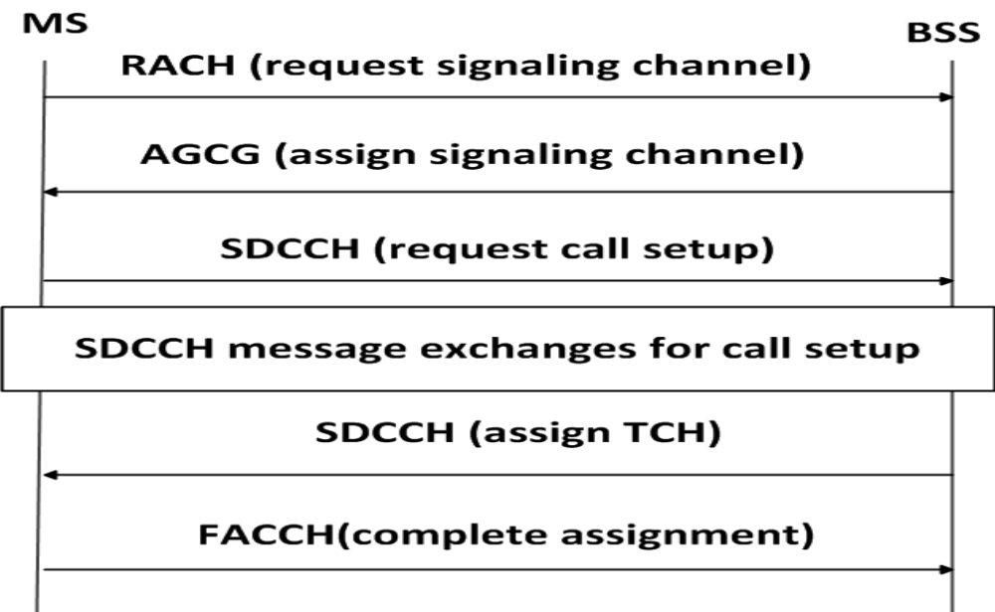
GSM Call Origination (Radio Aspect)

Slide 26
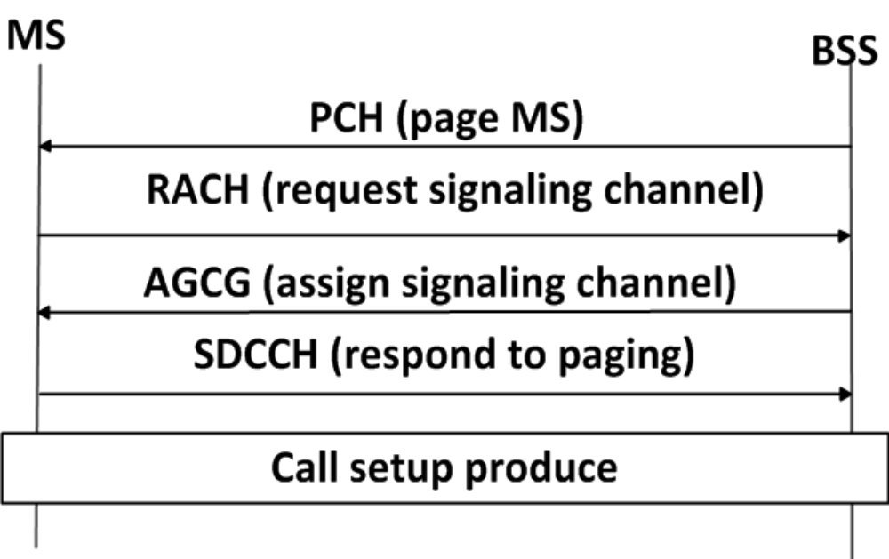
GSM Call Termination (Radio Aspect)

Slide 27
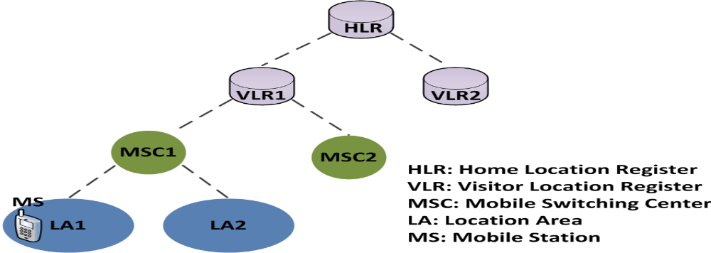
GSM Mobility Management
To exercise location tracking, a mobile service area is partitioned into several Location Areas (LA) or registration areas.
    Every LA consists of a group of BTSs.
The major task of mobility management is to update the location of an MS when it moves from one LA to another.
GSM Location Area Hierarchy

Slide 28
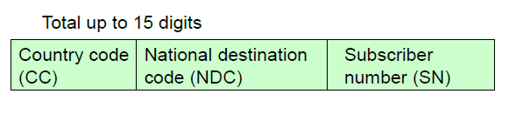
Identification Numbers in GSM
Mobile system ISDN (MSISDN)
Mobile Station International Subscriber Directory Number (MSISDN) uses the same format as the ISDN address (based on ITU-T Recommendation E.164).
HLR uses MSISDN to provide routing instructions to other components in order to reach the subscriber.
Mobile Station Roaming Number (MSRN)
Mobile Station Roaming Number
The routing address to route the call to the MS through the visited MSC.
        MSRN=CC+NDC+SN
Notes:
Stands for "Integrated Services Digital Network." ISDN is a telecommunications technology that enables the transmission of digital data over standard phone lines. It can be used for voice calls as well as data transfers
MSISDN means Mobile Station International Subscriber Directory Number and it's a number used to identify a phone number internationally. It

Slide 29
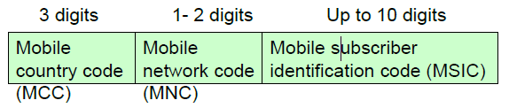
International Mobile Subscriber Identity (IMSI)
Each mobile unit is identified uniquely with an IMSI.
IMSI includes the country, mobile network, mobile subscriber.
Total up to 15 digits

Slide 30
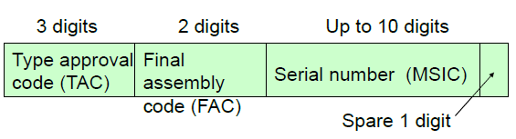
Temporary Mobile Subscriber Identity (TMSI)
TMSI is an alias used in place of the IMSI.
This value is sent over the air interface in place of the IMSI for purposes of security.
International Mobile station Equipment Identity (IMEI)
IMEI is assigned to the GSM at the factory.
When a GSM component passes conformance and interoperability tests, it is given a TAC.
Up to 15 digits

Slide 31
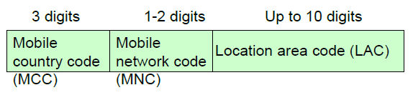
Location Area Identity(LAI )
LAI identifies a location area (LA).
When an MS roams into another cell, if it is in the same LAI, no information is exchanged.
Total up to 15 digits
Notes:
Cell Global Identity (CGI)
CGI = LAI + CI
= MCC + MNC + LAC + CI
CI : Cell Identity

Slide 32
Location Update Concept (Registration)
The location update (registration) procedure is initiated by the MS.
Step 1. The BTs periodically broadcast the corresponding LA addresses to the MSs.
Step 2. When an MS receives an LA address different from the one stored in it memory, it sends a registration message to the network.
  Note that :Every VLR maintains the information of a group of LAs. When an MS visits an LA, a temporary record of the MS is created in the VLR to indicate its location (i.e. LA address).
  For every MS, a permanent record is maintained in HLR. The record stores the address of VLR visited by the MS.

Slide 33
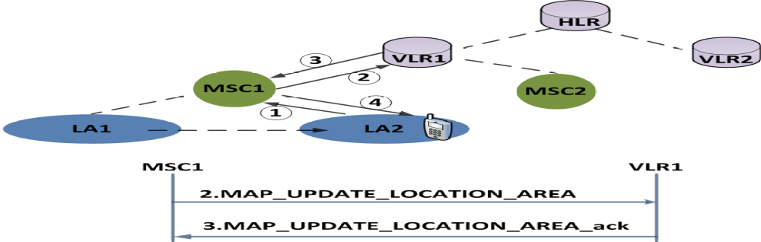
GSM Basic Location Update Procedure
Case 1. Inter-LA Movement
The MS moves from LA1 to LA2, where both LAs are connected to the same MSC.
In GSM 04.08, Nine message are exchanged between the MS and the MSC, and ten messages are exchanged between the MSC and the VLR.
figure : Inter-LA Registration Message Flow

Slide 34
Step 1.
A location update request message is sent
  (MS->BTS->MSC) .
Location Update Request (Prev. LA, Prev. MSC, Prev. VLR). Note that New MSC = Prev. MSC, New VLR = Prev. VLR
  The MS identifies itself by the Temporary Mobile Subscriber Identity (TMSI), which is an alias for IMSI.
  IMSI (International Mobile Subscriber Identity) is used to identify the called. IMSI is not known to the User but GSM network.
  TMSI is used to avoid sending the IMSI on the radio path, which is temporary identity is allocated to an MS by the VLR at inter-VLR registration, and can be changed by the VLR.

Slide 35
Step 2.
The MSC forwards the location update request to the VLR by a TCAP message, MAP_UPDATE_LOCATION_AREA.
This message includes (Address of the MSC, TMSI of MS, Prev. Location Area Identification (LAI), Target LAI, Other Related Information).
Steps 3 and 4.
Part I. The VLR notices that both LA1 and LA2 belong to the same MSC.
Part II. The VLR updates the LAI field of the VLR record.
Part III. The VLR replies an ACK to the MS through the MSC.

Slide 36
Inter-MSC Movement
The two LAs belong to different MSCs of the same VLR.
Steps 1 and 2. The location update request is sent from the MS to the VLR.
Step 3.
    Part I. The VLR notices that the Prev. LA and the Target LA belong to MSC1 and MSC2, which are connected to the same VLR, respectively.
    Part II. The VLR updates the LAI and the MSC fields of the VLR record.
    Part IV. The VLR derives the HLR address of the MS from the MS’s IMSI stored in the VLR record.
    Part V. The VLR sends the MAP_UPDATE_LOCATION to the HLR.

Slide 37
Step 4.
  Part I. By using the received IMSI, the HLR identifies the MS’s record.
  Part II. The MSC number field of the record is updated.
  Part III. An acknowledgement is sent VLR.
Steps 5 and 6.
  Similar to steps 3 and 4 in Inter-BTS movement, the acknowledgement is forwarded to the MS.

Slide 38
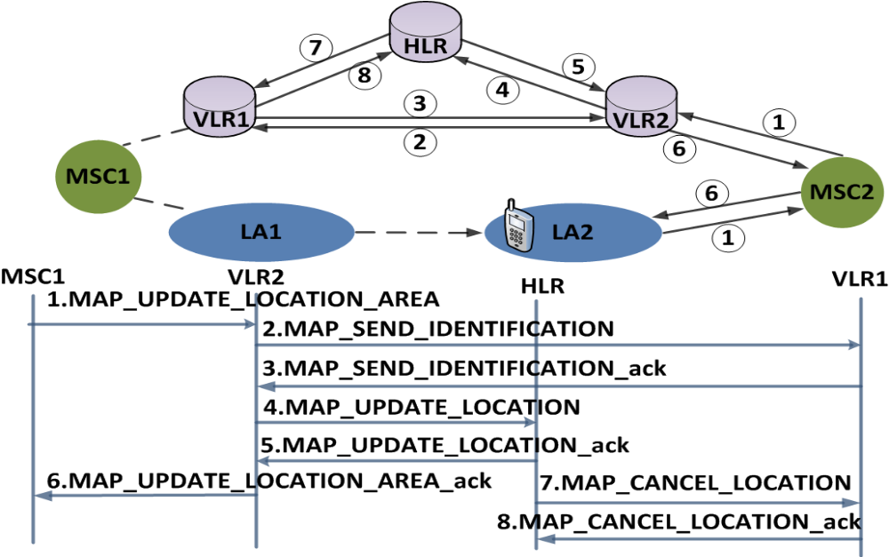
Inter-VLR Registration Message Flow

Slide 39
Step 1. The location update request is sent from MS to the VLR.
Steps 2 and 3. Part I. Since the MS moves from VLR1 to VLR2, VLR2 does not have a VLR record of the MS, and the IMSI of the MS is not known.
Part II. From the MAP_UPDATE_LOCATION_AREA message, VLR2 identifies the address the VLR1.
Part III. VLR2 sends MAP_SEND_IDENTIFICATION to VLR1.
Note that to enhance security, confidential data (IMSI) typically is not sent over the air.

Slide 40
Steps 4 and 5. VLR2 creates a VLR record for the MS, and sends a registration message to update the HLR.
  The HLR updates the record of the MS.
  An acknowledge is sent back to VLR2.
Step 6. VLR2 generates a new TMSI and sends it to the MS. In GSM, the TMSI is changed from time to time to avoid fraudulent usage.
Steps 7 and 8. The obsolete record of the MS in VLR1 is deleted.

Slide 41
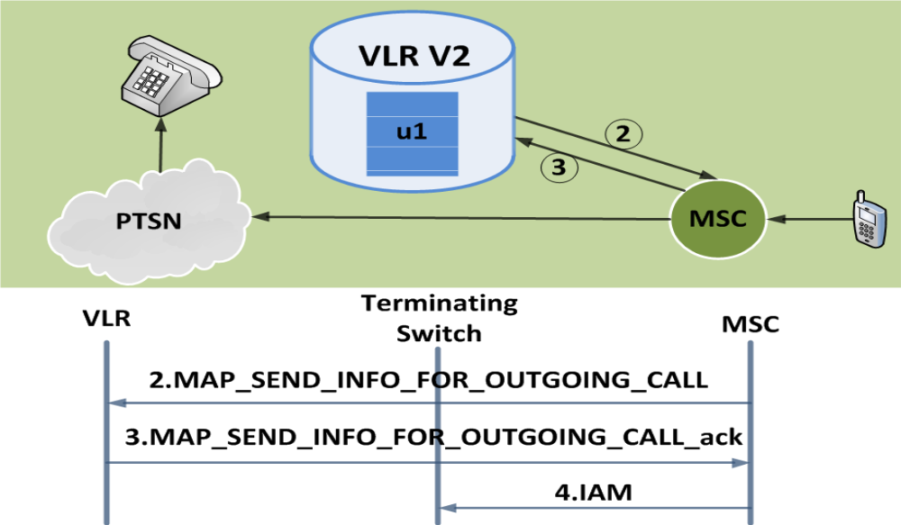
Call Origination Operation

Slide 42
GSM Basic Call Origination
Step 1. The MS u1 sends the call origination request to the MSC.
Step 2. The MSC forwards the request to the VLR by sending MAP_SEND_INFO_FOR_OUTGOING_CALL.
Step 3. The VLR checks the u1’s profile and sends MAP_SEND_INFO_FOR_OUTGOING_CALL_ack to the MSC to grant the call request.
Step 4. The MSC sets up the trunk according to the standard PSTN call setup procedure.

Slide 43
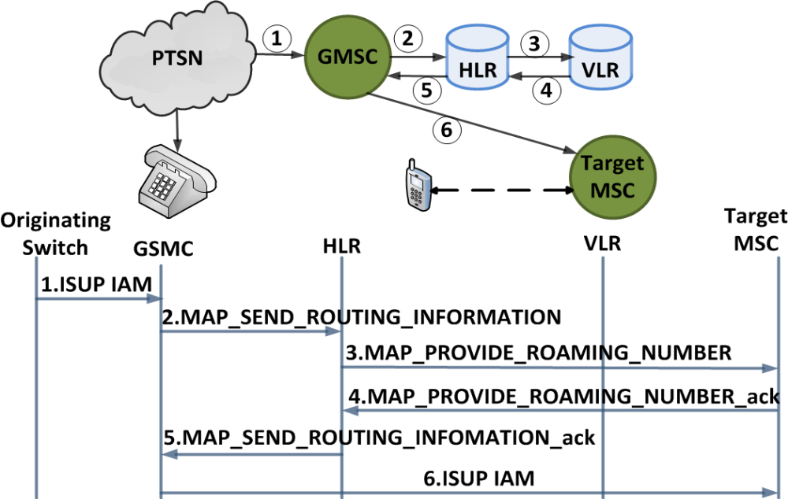
Call Termination Message Flow (Simplified Version)

Slide 44
Step 1. When the MSISDN number is dialed by a PSTN user, the call is routed to a gateway MSC by an SS7 ISUP IAM message.
Step 2. To obtain the routing information, the GMSC or ISDN exchange interrogates the HLR by sending MAP_SEND_ROUTING_INFORMATION to the HLR. The message contains the MSISDN of the MS and other related info.
Step 3. The HLR sends a MAP_PROVIDE_ROAMING_NUMBER message to the VLR to obtain the Mobile Subscriber Roaming Number (MSRN). The message consists of IMSI of the MS, the MSC number.

Slide 45
Steps 4 and 5. The VLR creates the MSRN by using the MSC number stored in the VLR record of the MS. This roaming number is sent back to the gateway MSC through the HLR.
Step 6. The MSRN provides the address of the target MSC where the MS resides. An SS7 ISUP IAM message is directed from the gateway MSC to the target MSC to setup the voice trunk.

Slide 46
Security
  Authentication Center (AUC)
    Used to protect user identity and data transmission.
    authentication parameters and Encryption keys are generated and stored
    May be situated in special protected part of the HLR
Notes:
Operation subsystem
enables centralized management and maintenance of all GSM subsystems
Components
Authentication Center (AUC)
Used to protect user identity and data transmission.
authentication parameters and Encryption keys are generated and stored
May be situated in special protected part of the HLR
Equipment Identity Register (EIR)
registers GSM mobile stations devices
Black list(stolen or locked ), Gray list( malfunctioning MS)
White list (Valid devices)
Operation and Maintenance Center (OMC)
control and monitor radio subsystem and the network subsystem entities via the O interface .
Traffic monitoring , status report of the network entities

Slide 47
DATA SERVICES
GSM phase 2 standard supports two data services.
    Short Message Services (SMS)
    Bearer Services are similar to the ISDN services, and the maximum data rate is 9.6 Kbps.
GSM phase 2+ standard supports two data services.
    High-Speed Circuit-Switched Data (HSCSD) for high-speed file transfers and mobile video applications
    General Packet Radio Service (GPRS) for bursty data applications such as e-mail and WWW.
    The data rates are expected to be raised from 9.6 Kbps to 28.8 Kbps or higher.
Notes:
High-Speed Circuit-Switched Data (HSCSD)(1/2)
HSCSD is a circuit-switched protocol for large file transfer and multimedia applications.
The physical layer of HSCSD is the same as that for the Phase 2 GSM data services.
The data rate of HSCSD has been increased by using multiple TDMA time slots (up to 8).
The radio interface is the same as that of the current GSM system except that multiple, independent time slots can be utilized to provide high-speed link.
•The radio link protocol (RLP) has been enhanced in HSCSD to support multi time-slot operation.
•In June 1999, Nokia announced Card Phone 2.0 for HSCSD with 43.2 Kbps.

Slide 48
High-Speed Circuit-Switched Data (HSCSD)
HSCSD is a circuit-switched protocol for large file transfer and multimedia applications.
The physical layer of HSCSD is the same as that for the Phase 2 GSM data services.
The data rate of HSCSD has been increased by using multiple TDMA time slots (up to 8).
The radio interface is the same as that of the current GSM system except that multiple, independent time slots can be utilized to provide high-speed link.
The radio link protocol (RLP) has been enhanced in HSCSD to support multi time-slot operation.
In June 1999, Nokia announced Card Phone 2.0 for HSCSD with 43.2 Kbps.

Slide 49
Chapter Seven
Part 2
General Packet Radio Service (GPRS)
Wireless Mobile Networks(CSE5309)

Slide 50
Overview of GPRS
GPRS is a third-generation step toward internet access.
It is also known as GSM-IP that is a Global-System Mobile Communications Internet Protocol as it keeps the users of this system online, allows to make voice calls, and access internet on-the-go.
Even Time-Division Multiple Access TDMA users benefit from this system as it provides packet radio access.
GPRS also permits the network operators to execute an Internet Protocol IP based core architecture for integrated voice and data applications that will continue to be used and expanded for 3G services.

Slide 51
The packet radio principle is employed by GPRS to transport user data packets in a structure way between GSM mobile stations and external packet data networks.
These packets can be directly routed to the packet switched networks from the GPRS mobile stations.
Provide Higher Data Rate : GPRS benefits the users in many ways, one of which is higher data rates in turn of shorter access times.
Used for Easy Billing: GPRS packet transmission offers a more user-friendly billing than that offered by circuit switched services.
Notes:
In the typical GSM mobile, setup alone is a lengthy process and equally, rates for data permission are restrained to 9.6 kbit/s.
The session establishment time offered while GPRS is in practice is lower than one second and ISDN-line data rates are up to many 10 kbit/s.
In circuit switched services, billing is based on the duration of the connection.

Slide 52
APPLICATIONS GPRS
Mobility - The ability to maintain constant voice and data communications while on the move.
Immediacy - Allows subscribers to obtain connectivity when needed, regardless of location and without a lengthy login session.
Localization - Allows subscribers to obtain information relevant to their current location.
Communications - E-mail, fax, unified messaging and intranet/internet access, etc.
Value-added services - Information services and games, etc.
E-commerce - Retail, ticket purchasing, banking and financial trading, etc.
Location-based applications - Navigation, traffic conditions, airline/rail schedules and location finder, etc.
Vertical applications - Freight delivery, fleet management and sales-force automation.

Slide 53
GPRS Architecture
GPRS architecture works on the same procedure like GSM network, but, has additional entities that allow packet data transmission. This data network overlaps a second-generation
GSM network providing packet data transport at the rates from 9.6 to 171 kbps.
Along with the packet data transport the GSM network accommodates multiple users to share the same air interface resources concurrently.
Following is the GPRS Architecture diagram:
GPRS attempts to reuse the existing GSM network elements as much as possible,

Slide 54
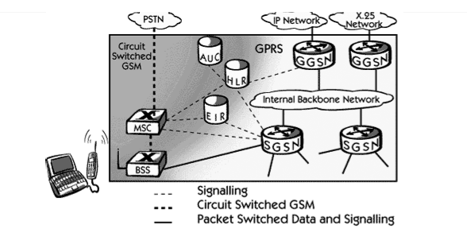
But to effectively build a packet-based mobile cellular network, some new network elements, interfaces, and protocols for handling packet traffic are required.
Therefore, GPRS requires modifications to numerous GSM network elements as to provide a full services

Slide 55
GPRS Support Nodes
Following two new components, called Gateway GPRS Support Nodes GGSN and, Serving GPRS Support Node SGSN are added:
Gateway GPRS Support Node GGSN
    The Gateway GPRS Support Node acts as an interface and a router to external networks.
    It contains routing information for GPRS mobiles, which is used to tunnel packets through the IP based internal backbone to the correct Serving GPRS Support Node.
The GGSN also collects charging information connected to the use of the external data networks and can act as a packet filter for incoming traffic.

Slide 56
Serving GPRS Support Node SGSN
The Serving GPRS Support Node is responsible for authentication of GPRS mobiles, registration of mobiles in the network, mobility management, and collecting information on charging for the use of the air interface.
Internal Backbone
The internal backbone is an IP based network used to carry packets between different GSNs.
Tunneling is used between SGSNs and GGSNs, so the internal backbone does not need any information about domains outside the GPRS network.

Slide 57
Signaling from a GSN to a MSC, HLR or EIR is done using SS7.
Routing Area
GPRS introduces the concept of a Routing Area. This concept is similar to Location Area in GSM, except that it generally contains fewer cells.
Because routing areas are smaller than location areas, less radio resources are used While broadcasting a page message.

Slide 58
GPRS quality of service
Quality of Service QoS requirements of conventional mobile packet data applications are in assorted forms.
The QoS is a vital feature of GPRS services as there are different QoS support requirements for assorted GPRS applications like real-time multimedia, web browsing, and e-mail transfer.

Slide 59
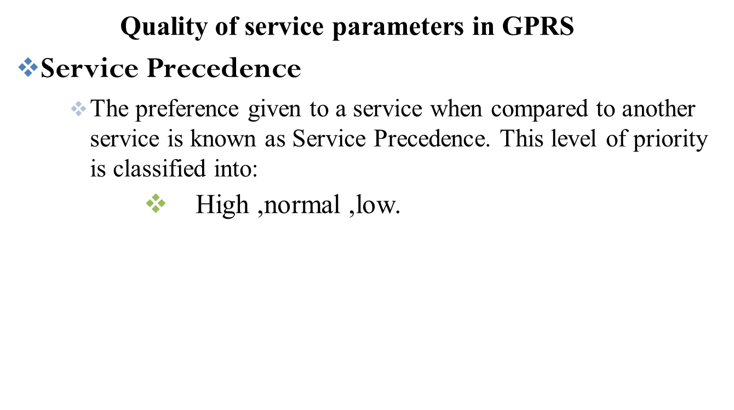

Slide 60

End of Chapter Seven
Thank
You for Your
Attention

